Slide 1



JASPAR: an open-access database of transcription factor binding profiles
Dr. Oriol Fornes
Deputy Group Leader @ Wasserman Lab
Centre for Molecular Medicine and Therapeutics
BC Children’s Hospital Research Institute
University of British Columbia
oriol@cmmt.ubc.ca
@OFornes
GREEKC Meeting – February 13, 2018
Notes:
Thank you very much Phillip for your kind introduction. First of all, I want to take the opportunity to thank the organizers for inviting me to the GREEKC Meeting in Ljubljana. Today, I will be talking about the 2018 release of JASPAR, which has been recently published in the NAR Database Issue, and describe its new and improved features and tools.

Slide 2
Outline
Overview
Manual Curation
Tools:
Profile Inference
Matrix Clustering
Genome Tracks
New Web Interface
RESTful API
Perspectives
MANTA2
Notes:
Here is an outline of my presentation. I will start with a brief overview of JASPAR, followed by the curation process that we perform before adding/updating any new binding profiles to the database. Then, I will describe you some of the most recent tools that we have developed. I will also describe some of the improved new web features, including the RESTful API that grants universal programmatic access to JASPAR, and finally some future perspectives that we are exploring. If I had time, I would like to introduce our recently updated MANTA database.

Slide 3
Overview
JASPAR is one of the most popular and longest maintained databases of TF binding profiles (>4,000 citations)
2004
2006
2008
2010
2014
2016
2018
Notes:
So JASPAR is one of the most popular and longest maintained databases of TF binding profiles. It was initially published in 2004 and, since then, there have been 7 releases, approximately one every two years.

Slide 4
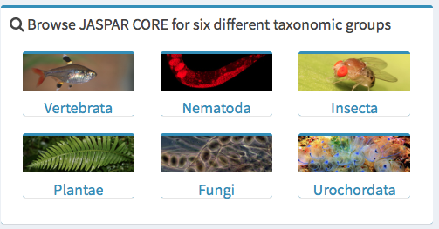
Overview
human, mouse, rat, zebra fish…
C. elegans
Drosophila
Arabidopsis
yeast
Notes:
JASPAR comprises TF binding profiles from species in 6 different taxonomic groups. For example, for vertebrates, we include profiles from human, mouse, rat, and zebra fish, among other species, while for nematodes, insects, plants and fungi, profiles are mainly from C. elegans, Drosophila, Arabidopsis and yeast, respectively. In case you wonder, JASPAR only stores one profile for urochordates.

Slide 5
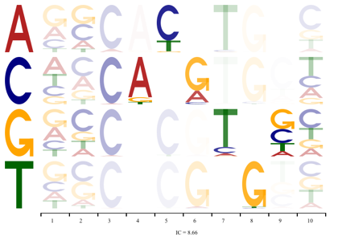
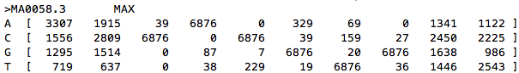
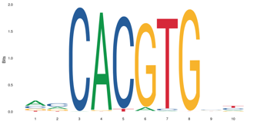
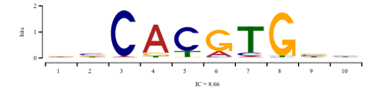
Overview
…attaaAACCACATGTacgat…
…ctcccTTGCACATGGccttt…
…cacacAAACACGTGGgtgca…
…tgtttGAGCACGTGTctggg…
…tgtgtATGCACATGTactca…
…tgtgcATGCACATGTgcatg…
…
PFM
TFFM
Notes:
JASPAR stores two different kinds of profiles. For all TFs, it contains position frequency matrices, PFMs, while only for some, binding sites are also described as TF flexible models. TFFMs are more advanced models that PFMs and are based on hidden-Markov models. They account for both dependencies between nucleotide positions and binding sites of flexible length.

Slide 6
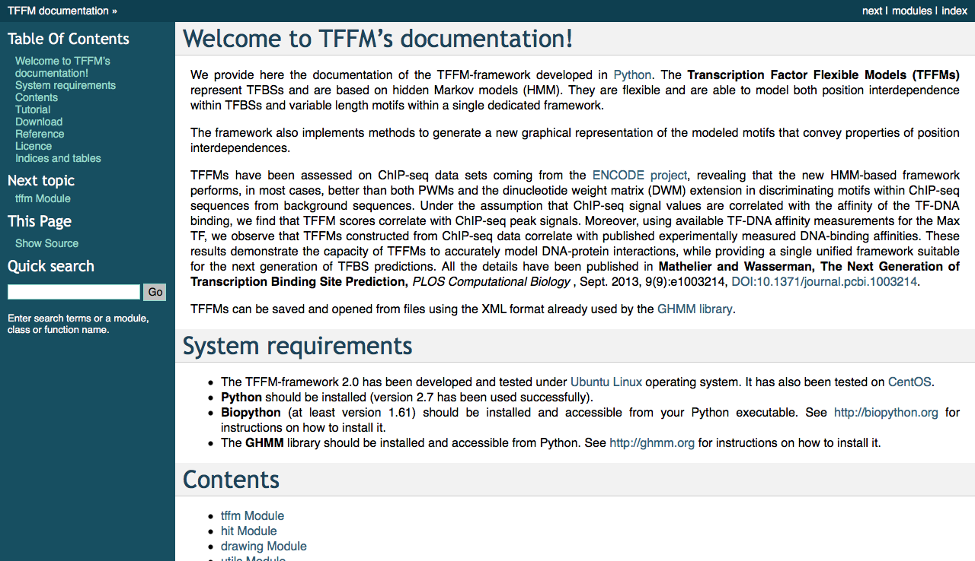
www.cisreg.ca/TFFM/doc/
Notes:
I am not going to describe TFFMs in detail, but for more information, feel free to check the documentation provided at this website (point towards the top).

Slide 7
Overview
Taipale (Science)
ReMap (ChIP-seq)
DAP-seq
SMiLE-seq
Taipale (HT-SELEX)
CIS-BP (PBM)
Total profiles
ChIP-seq
TFFM paper
Notes:
JASPAR owes its growth to different technological advances that have occurred over the years. For example, between the versions 2008 and 2010, the growth is owed to the emergence of the ChIP-seq technology, while the expansion of the latest release is mainly due to the ReMap of ChIP-seq data from ENCODE, GEO and ArrayExpress, and the emergence of DAP-seq (for plants) and SMiLE-seq. As you can see, TFFMs were included to JASPAR for the first time during the 2016 release, as it was only published in 2014. Finally, we have already started processing new data.

Slide 8
Overview
The JASPAR database as of 2018:
Experimental data sources: ChIP-chip/seq, DAP-seq, EMSA, PBM, (HT-)SELEX, SMiLE-seq…
Notes:
All in all, as of 2018, JASPAR contains over 14 hundred non-redundant PFMs, and almost 500 TFFMs, with TFs belonging to 64 different structural classes and 115 structural families, as defined by TFClass.

Slide 9
Outline
Overview
Manual Curation
Tools:
Profile Inference
Matrix Clustering
Genome Tracks
New Web Interface
RESTful API
Perspectives
MANTA2
Notes:
Now, I will describe the process that we follow for the manual curation of profiles.

Slide 10
Manual Curation
859 PFMs
literature
support?
yes
no
183 (6 non TFs)
yes
∃ in db?
no
111 added (new)
new binding mode?
better profile?
yes
no
no
493 (discarded)
19 added
(new binding modes)
yes
53 added (updated)
Notes:
As an example, I will provide statistics from my curation process on the recent data from the Taipale Lab. I started with 859 high-quality profiles in terms of information content (there were a few whose quality was not good). The first step in the curation process was to check whether profiles had literature support. For 183 profiles, I could not find any. In addition, 6 of the profiles were of non TF proteins.

Slide 11
Manual Curation
Notes:
By literature support, what I mean is finding one or more papers that say something like this highlighted text. For instance, the Irx family of TFs prefers this kind of sequence. I am showing you this paper because it has been key for adding most of homeodomain TFs to JASPAR.

Slide 12
Manual Curation
859 PFMs
literature
support?
yes
no
183 (6 non TFs)
yes
∃ in db?
no
111 added (new)
new binding mode?
better profile?
yes
no
no
493 (discarded)
19 added
(new binding modes)
yes
53 added (updated)
Notes:
The next step was to check whether the profile already exists in JASPAR. If not, they were added to the database. If existed, I checked if the profile was a new binding mode for the TF.

Slide 13
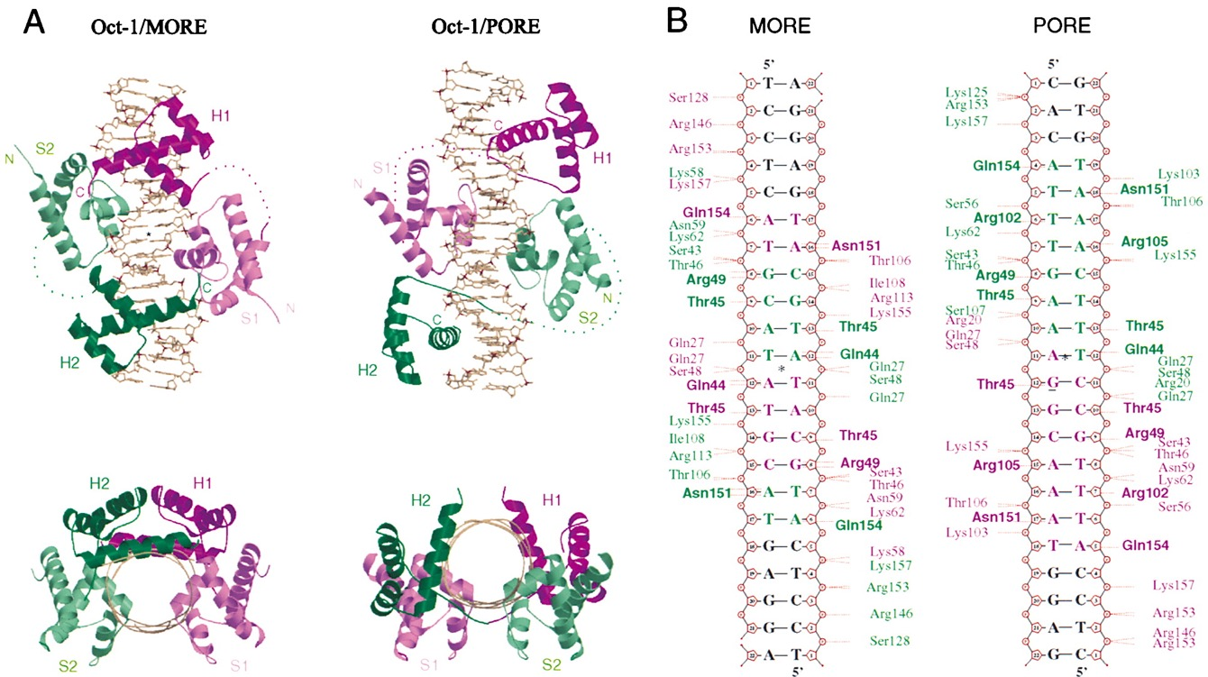
Manual Curation
Reményi A, et al. (2001)
Notes:
By binding mode I refer to the ability of some TFs, such as Oct-1, to bind DNA in different structural conformations, allowing the TF to have different DNA binding preferences for the MORE and PORE conformations.

Slide 14
Manual Curation
859 PFMs
literature
support?
yes
no
183 (6 non TFs)
yes
∃ in db?
no
111 added (new)
new binding mode?
better profile?
yes
no
no
493 (discarded)
19 added
(new binding modes)
yes
53 added (updated)
Notes:
If it was a new binding mode, it was added to JASPAR. If not, I checked if the profile was better than the previous profile. If it was, that profile updated the older version, otherwise it was discarded.

Slide 15
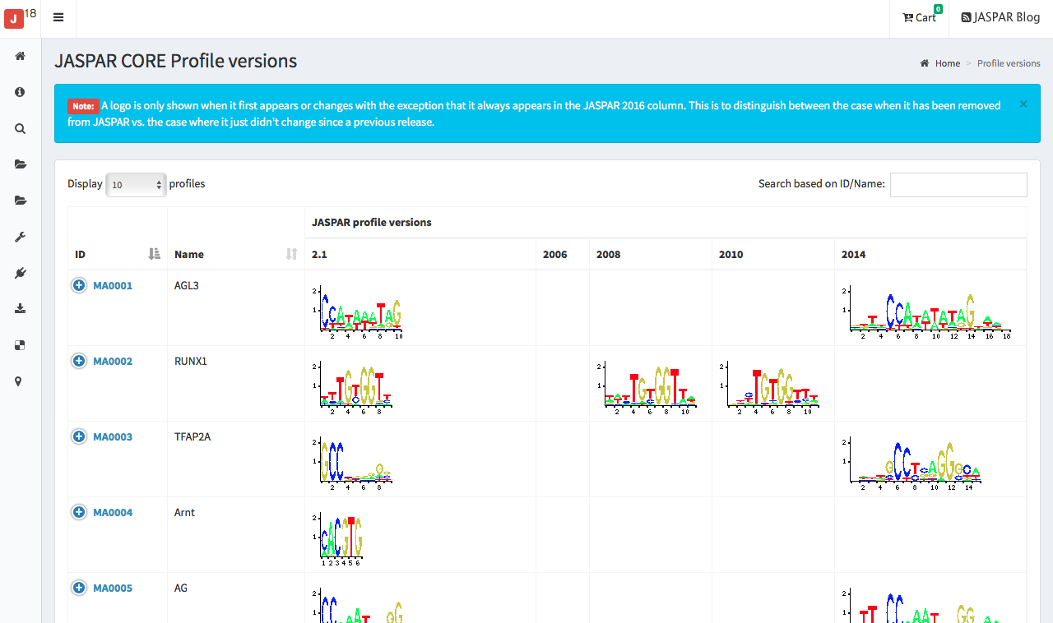
Manual Curation
Notes:
This process through all JASPAR releases is summarized in a recently added new web functionality that allows users to navigate across all versions of TF binding profiles.

Slide 16
Outline
Overview
Manual Curation
Tools:
Profile Inference
Matrix Clustering
Genome Tracks
New Web Interface
RESTful API
Perspectives
MANTA2
Notes:
Now, I will introduce some of the recent tools that we have developed. First, the profile inference tool was motivated to help JASPAR users who would recurrently ask for the right profile to use in their species of interest.

Slide 17
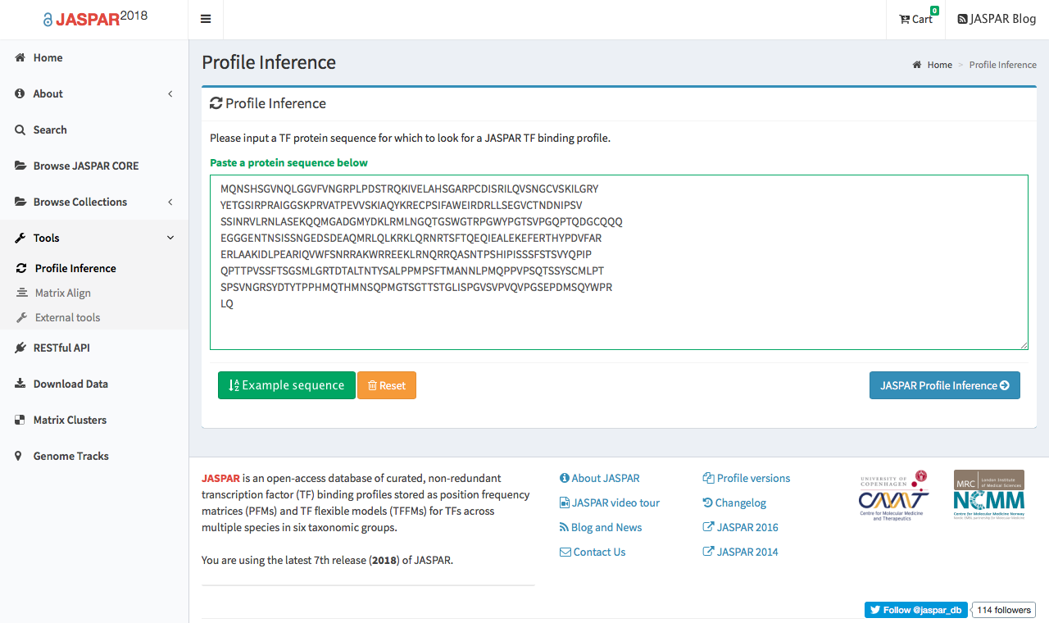
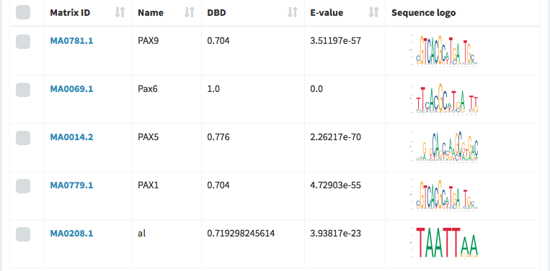
Profile Inference
Notes:
The tool offers a textbox to be filled with the sequence of your TF of interest, and upon clicking the blue button, it provides a list of profiles that potentially represent the binding preferences for your TF.

Slide 18
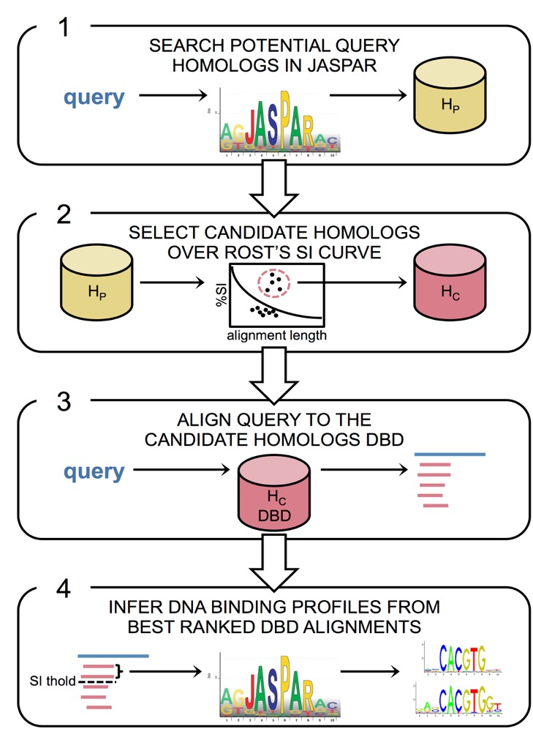
Profile Inference
Notes:
Internally, the tool searches JASPAR for potential homologs of the TF, and only those above the Rost’s sequence identity curve are kept.

Slide 19
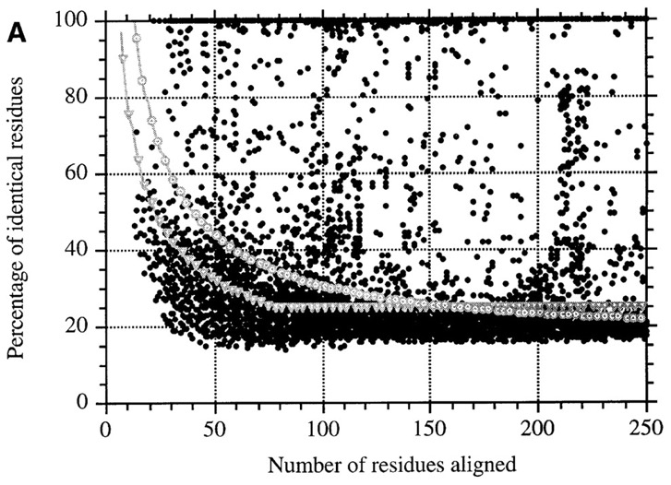
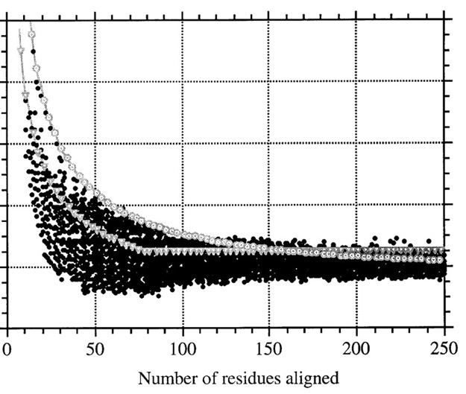
Profile Inference
homolog pairs
non-homolog pairs
Rost B (1999)
Notes:
The Rost’s curve sets a flexible threshold on the sequence identity for pairwise alignments. The threshold is very stringent for short alignments and becomes more lax with the number of aligned residues. For example, to infer that two proteins are homologs from short alignments, one requires a very high percentage of identical residues. In principle, the curve separates alignments between pairs of homologs from alignments between non-homologous pairs of proteins.

Slide 20
Profile Inference
Notes:
Then, the TF sequence is aligned against the DNA binding domains of its candidate homologs, and if the alignments are above a certain sequence identity threshold, then the binding profiles from the candidate homologs are assigned to the TF.

Slide 21
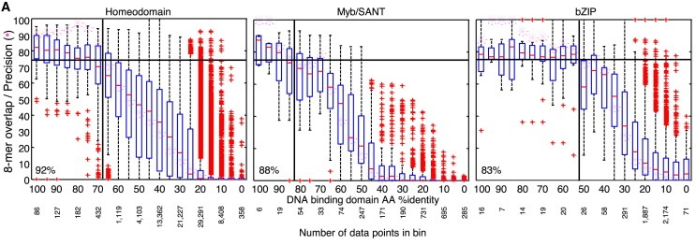
Profile Inference
Weirauch M, et al. (2014)
Notes:
The thresholds on the sequence identity for DNA binding domains are extracted from the CiS-BP paper, in which it was observed that for certain TF families, the percentage of shared identical bound DNA sequences was very high even when the sequence similarity between the binding domains of the members of the family was low, for instance the bZIP family. Yet for other TF families, a few amino acid changes were enough as to make members of the same TF family prefer different DNA sequences.

Slide 22
Outline
Overview
Manual Curation
Tools:
Profile Inference
Matrix Clustering
Genome Tracks
New Web Interface
RESTful API
Perspectives
MANTA2
Notes:
While non-redundancy is one of the guiding principles of JASPAR, TFs with similar DBDs often have similar binding preferences. To facilitate the exploration of similar profiles in the JASPAR CORE collection, Jaime performed a hierarchical clustering of the PFMs using the RSAT matrix-clustering tool. I invite you to direct any questions regarding the clustering of profiles to him.

Slide 23
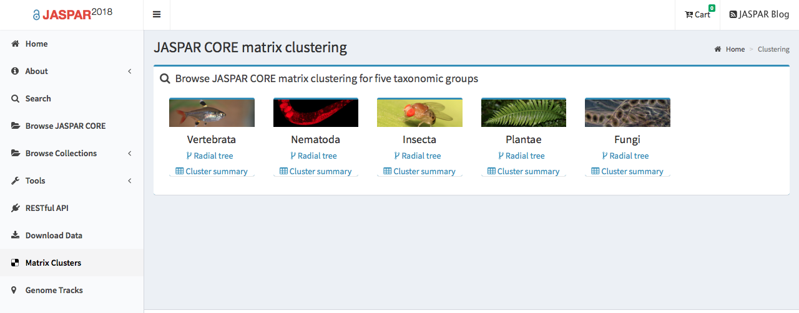
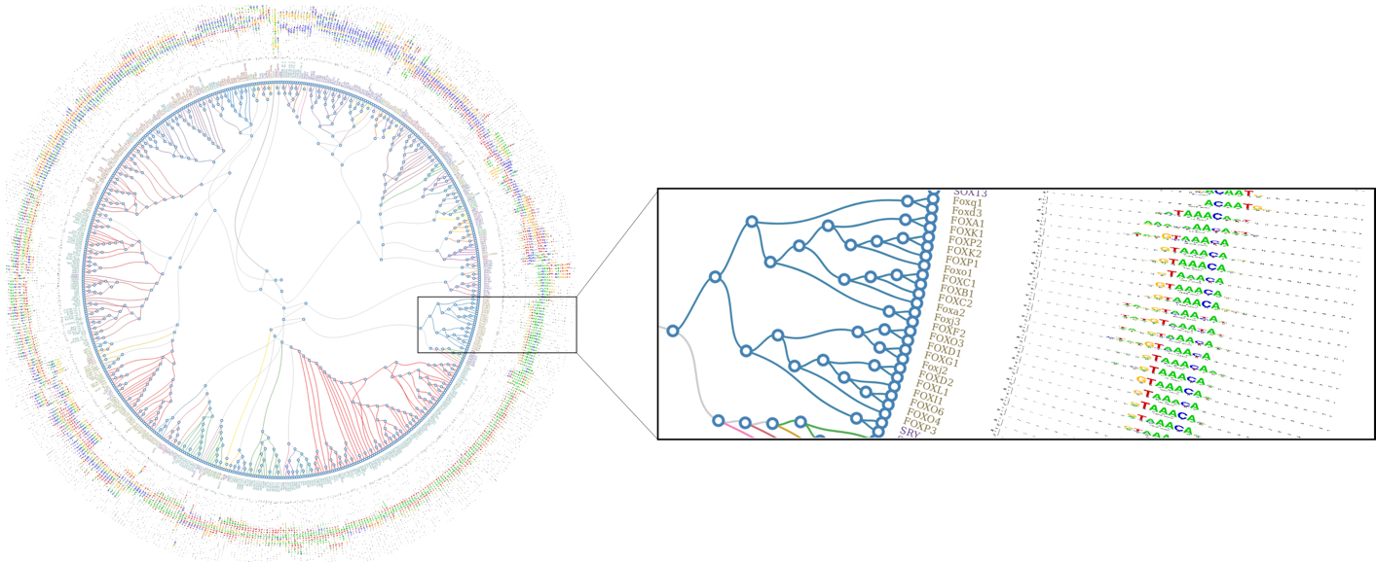
Matrix Clusters
Notes:
Specifically, the tool was applied to cluster profiles in each TF class per taxon. The clustering results are provided as radial trees (see below) with the profiles at the end of the leaves.

Slide 24
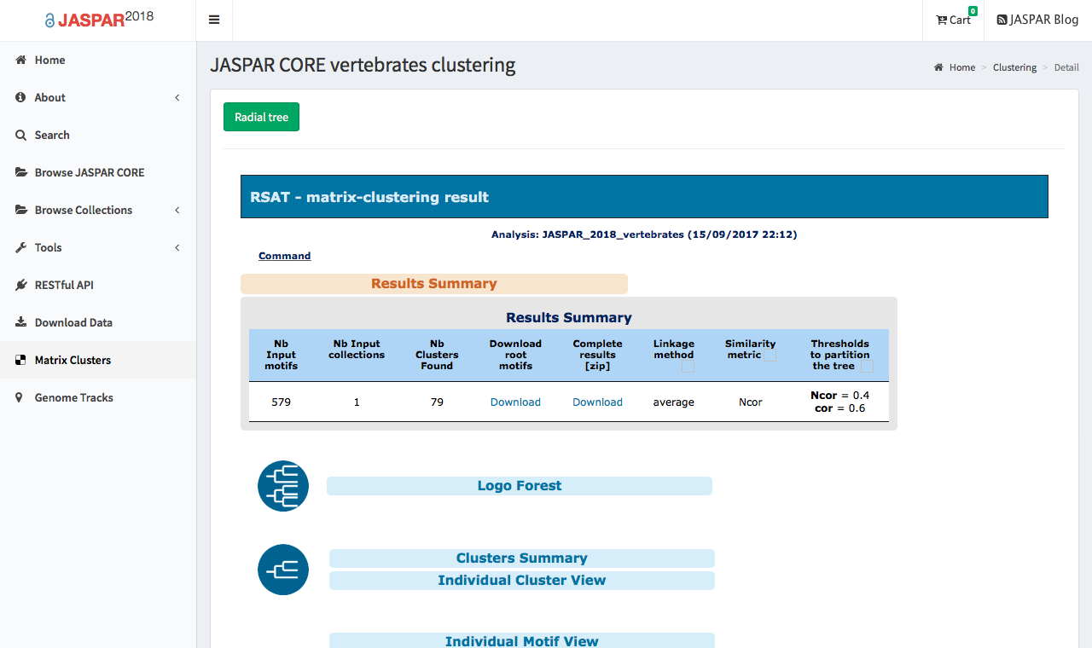
Matrix Clusters
Notes:
The clusters can further be explored through dedicated web pages, and downloaded for custom analysis.

Slide 25
Outline
Overview
Manual Curation
Tools:
Profile Inference
Matrix Clustering
Genome Tracks
New Web Interface
RESTful API
Perspectives
MANTA2
Notes:
Finally, I will introduce the JASPAR genome tracks.

Slide 26
Genome Tracks
Notes:
The tracks contain genome-wide TFBS predictions using the JASPAR CORE profiles.

Slide 27
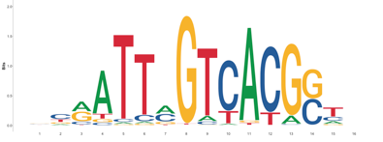
Genome Tracks
MEME
format
PWM
BioPerl TFBS
module
FIMO
rel. score
≧0.8
p-value
<0.05
matches
TFBS predictions
Notes:
Specifically, for each profile, a genome was scanned using the TFBS Perl module and FIMO from the MEME suite. For scan with the BioPerl TFBS module, profiles were converted to PWMs and matches with a relative score ≥0.8 were kept. For the FIMO scan, profiles were reformatted to MEME motifs and matches with a p-value <0.05 were kept. We only kept consistent predictions between the two methods. Then, predictions were converted to genome tracks and coloured according to their FIMO p-value (darker for low p-values). This allows for comparing predictions between different profiles.

Slide 28
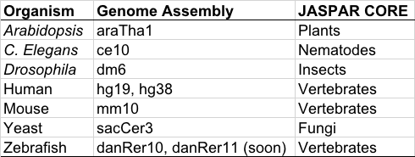
Genome Tracks
Availability: UCSC and Ensembl browsers, Track Hub Registry
Also at: expdata.cmmt.ubc.ca/JASPAR/downloads/UCSC_tracks/2018/
Notes:
To date, we offer genome tracks for all these species and genome assemblies via UCSC, Ensembl and the Track Hub Registry. All predictions and underlying BED files are available for download at our web servers.

Slide 29
Outline
Overview
Manual Curation
Tools:
Profile Inference
Matrix Clustering
Genome Tracks
New Web Interface
RESTful API
Perspectives
MANTA2
Notes:
One of the most significant updates for this JASPAR release is the new web interface.

Slide 30
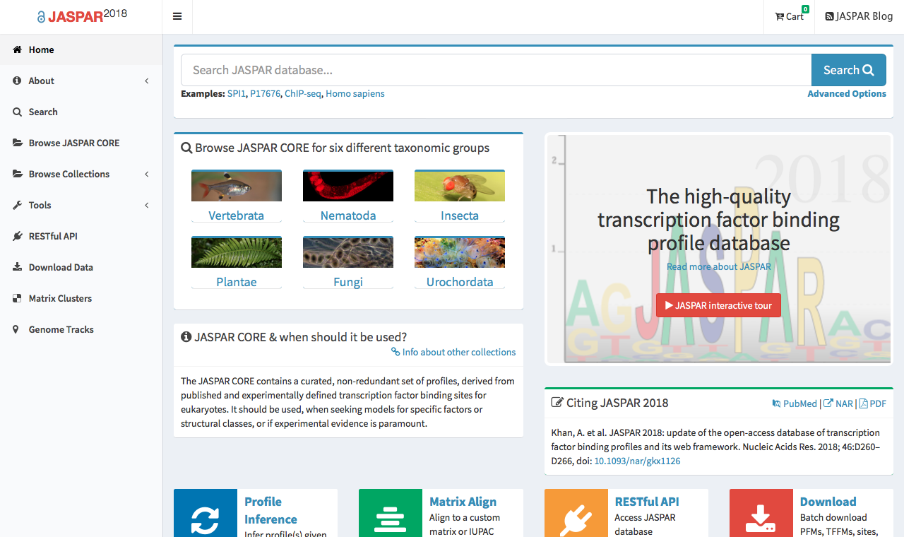
New Web Interface
Notes:
Here is an overview of the new web site. I remember when Anthony first interviewed me, he asked me why I hadn’t used JASPAR during my PhD research. I told him that the main reason was that it was very complicated to navigate. Since then, we had been talking about updating the web, making it more 2.0, as the web dated from the original release of JASPAR back in 2004.

Slide 31
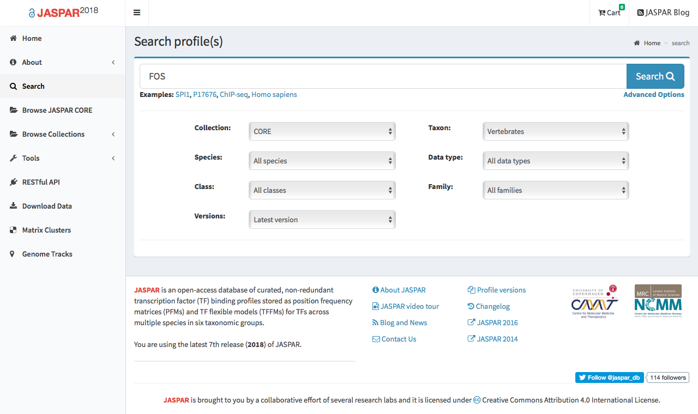
New Web Interface
Notes:
The new web comes with an improved search engine. It allows, for example, search for a given TF name in a specific collection, version or taxon.

Slide 32
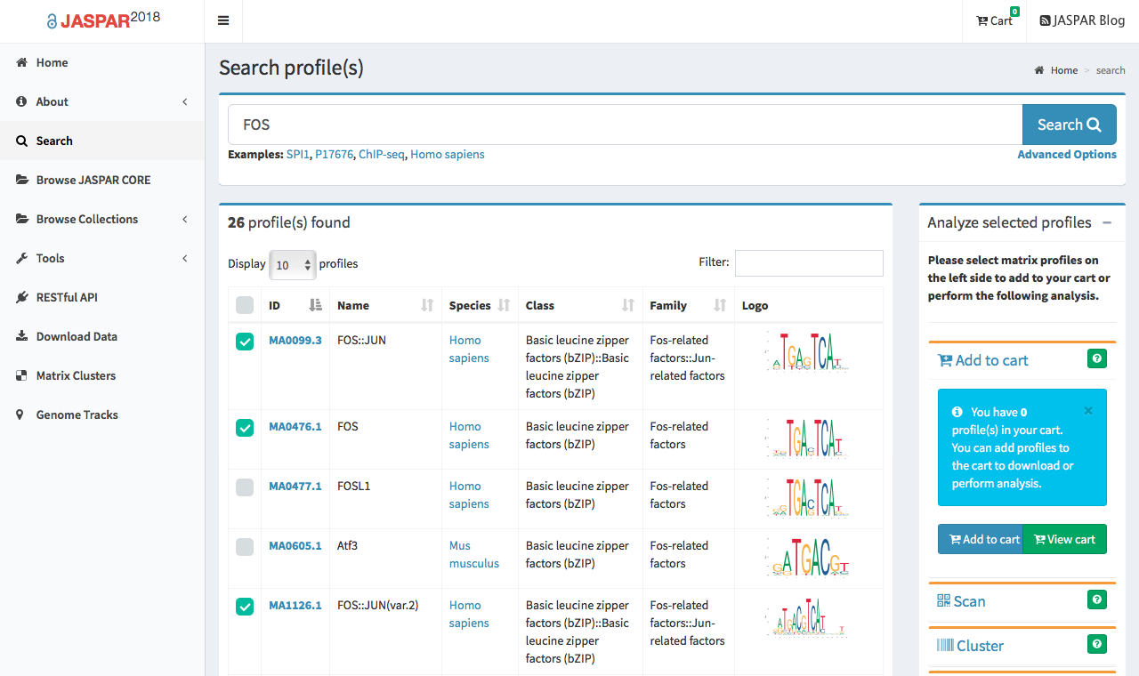
New Web Interface
Notes:
And here are the resulting profiles matching the criteria of our search, which can be, for example, selected and added to cart for custom analysis.

Slide 33
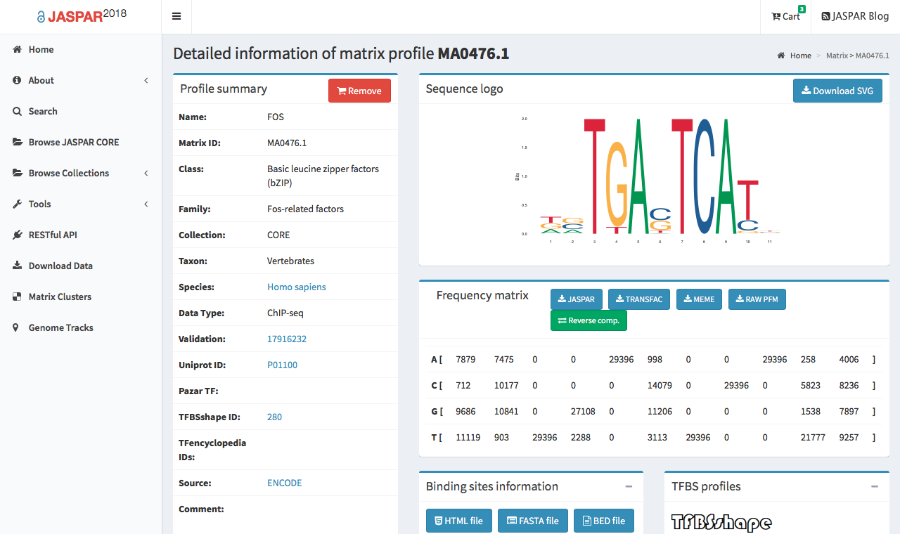
jaspar.genereg.net/matrix/MA0476.1/
Notes:
We have also introduced semantic URLs to facilitate external linking to the detailed pages of individual profiles.

Slide 34
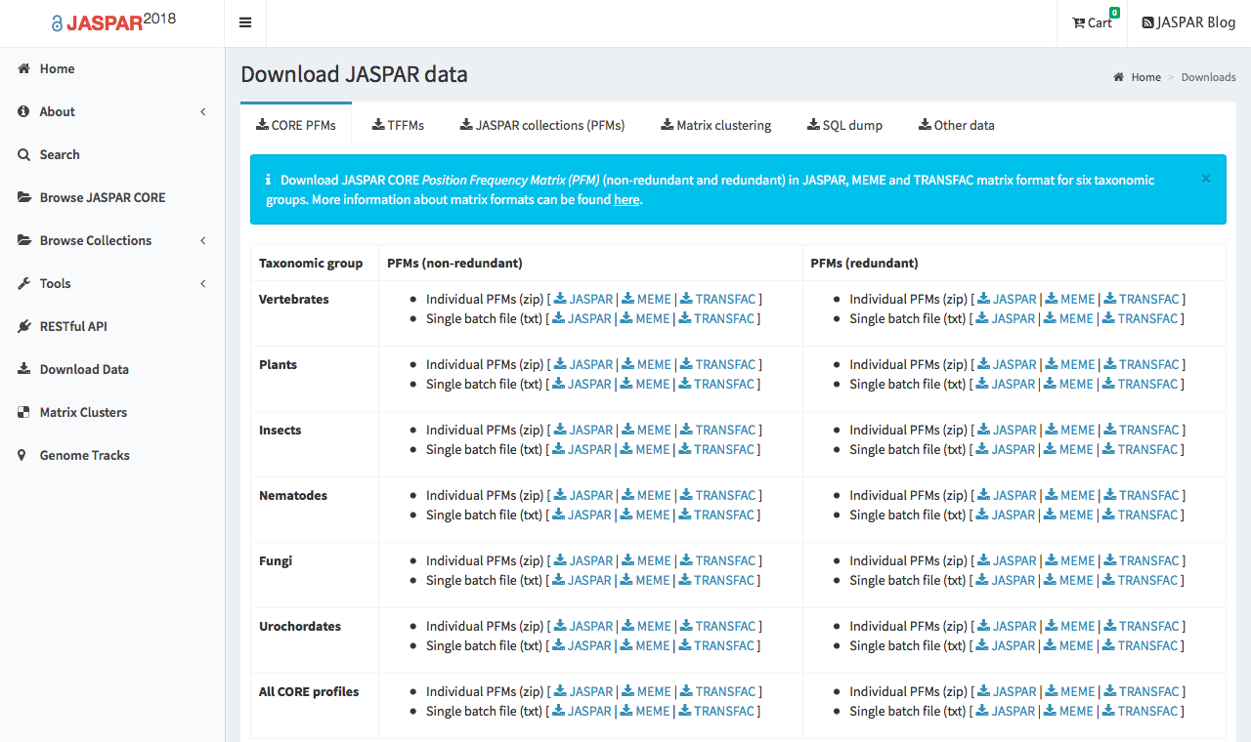
New Web Interface
Notes:
Finally, the downloads section allows for downloading profiles per taxonomic group in different formats, as a single batch or one file per profile, or even the entire database.

Slide 35
Outline
Overview
Manual Curation
Tools:
Profile Inference
Matrix Clustering
Genome Tracks
New Web Interface
RESTful API
Perspectives
MANTA2
Notes:
Probably, the second most significant update to JASPAR 2018 is its RESTful API.

Slide 36
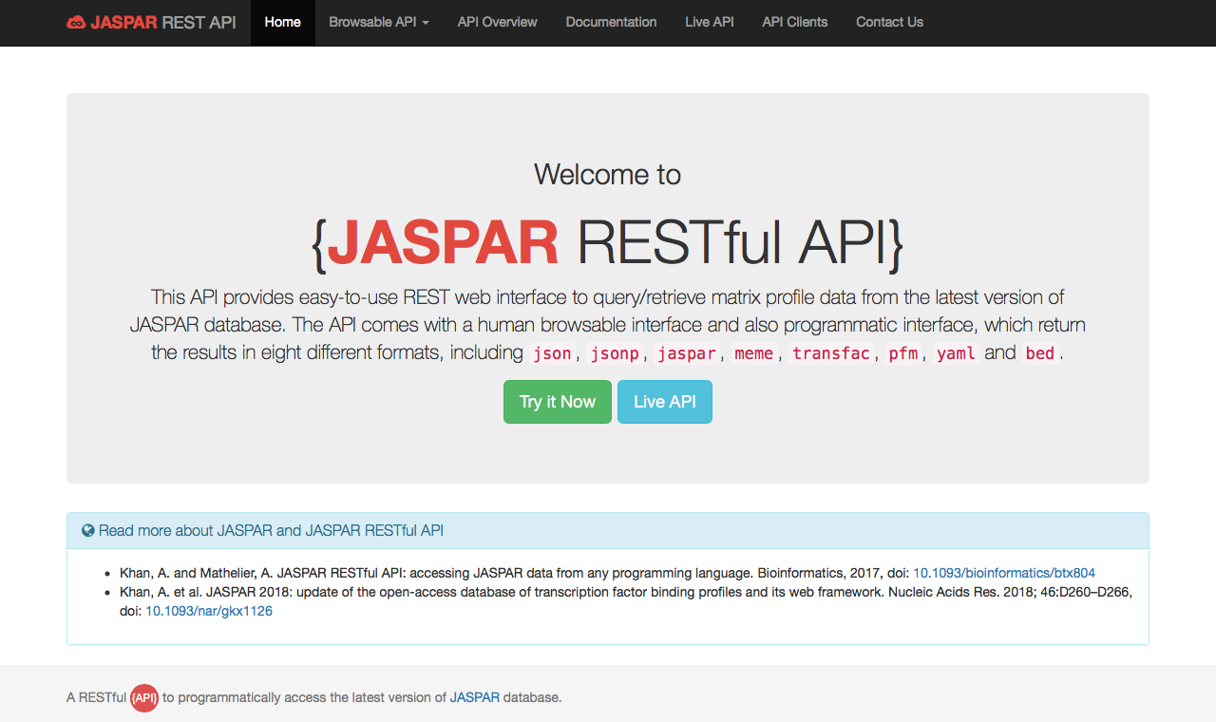
RESTful API
Notes:
The API provides an easy-to-use interface to query and retrieve data from JASPAR. The API comes with a browsable interface and a programmatic interface, which return results in several common formats, as for example JSON.

Slide 37
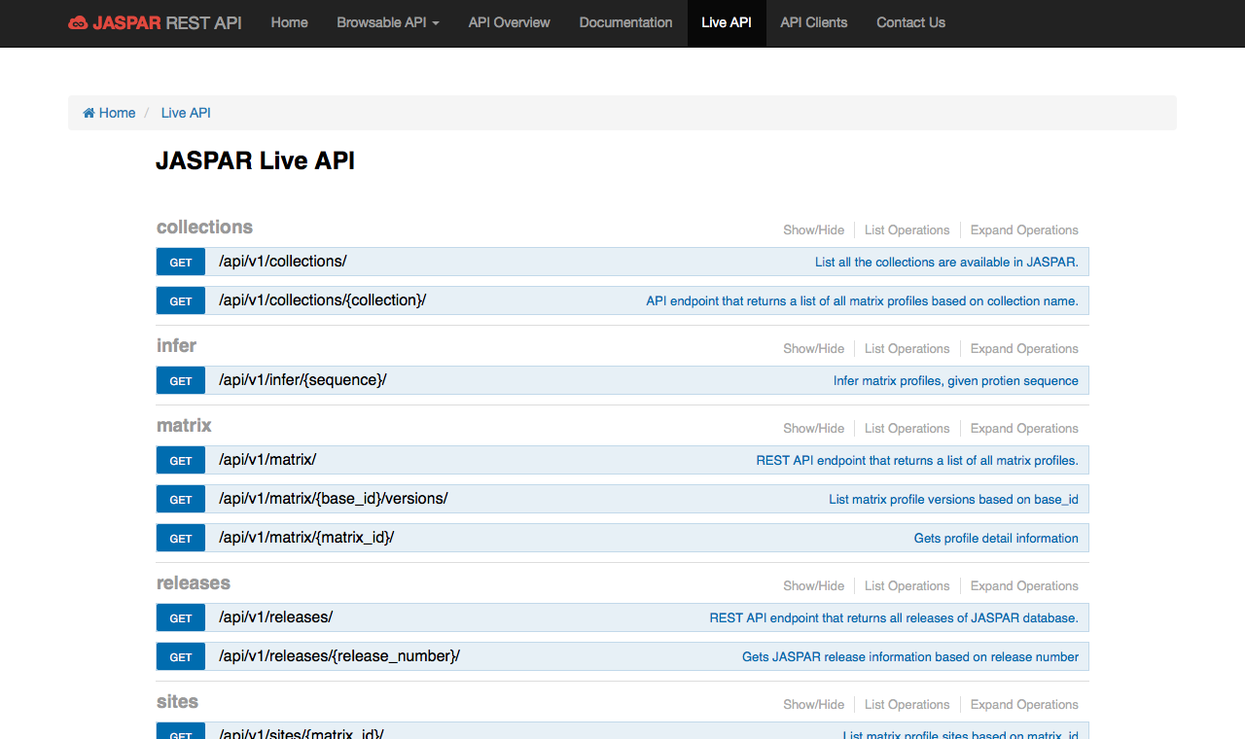
RESTful API
Notes:
The Live API provides several recipes to query the JASPAR collections and to access different JASPAR tools.

Slide 38
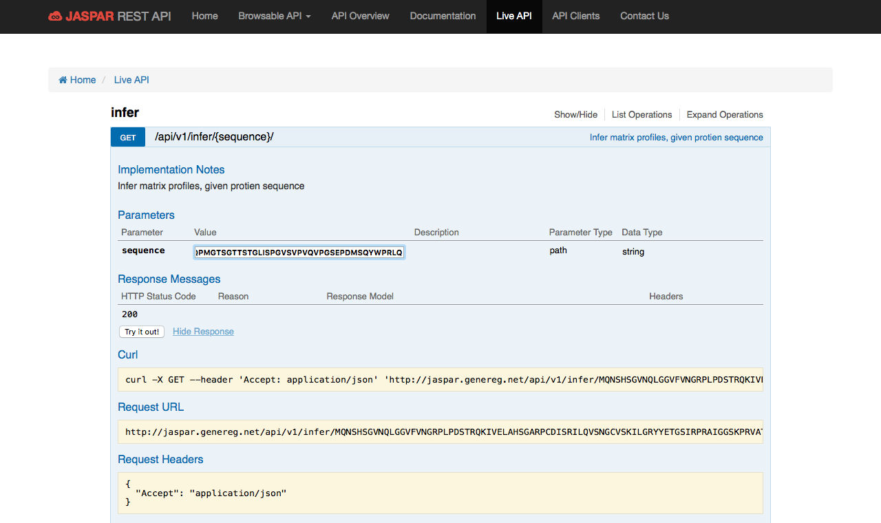
RESTful API
Notes:
For instance, it provides access to the profile inference tool. By pasting a sequence and clicking on try it out, it provides two ways of fetching the inferred profiles: either using CURL or through a URL request.

Slide 39
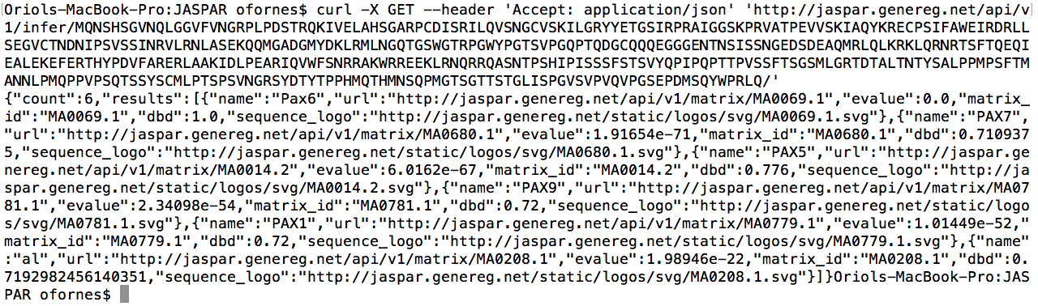
RESTful API
Notes:
In this screenshot of my terminal, you can see that the CURL command returns a JSON document with the inferred profiles.

Slide 40
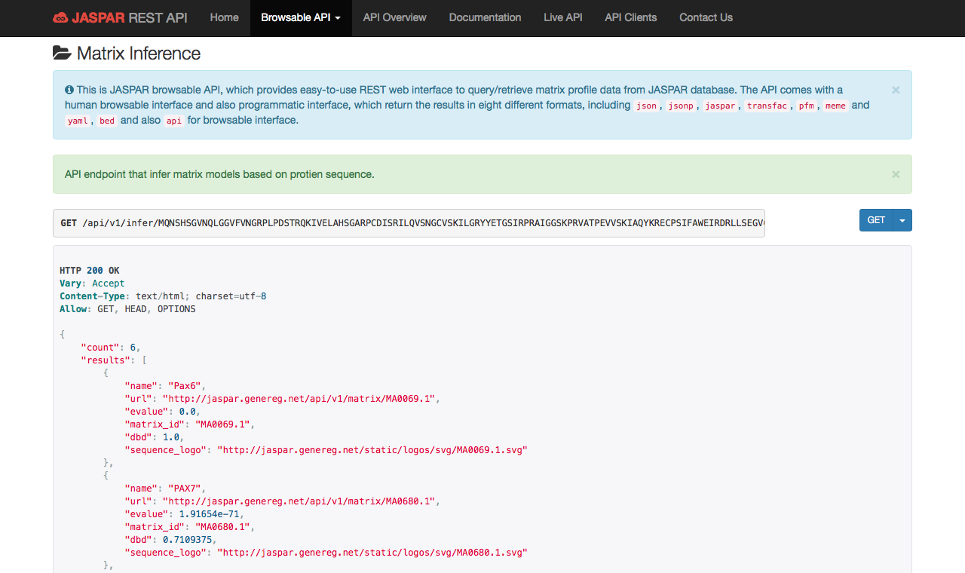
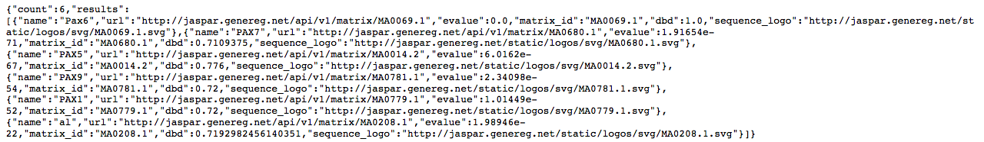
RESTful API
Notes:
Alternatively, one can just copy and paste the provided URL in the internet browser, and the API will output the inferred profiles. By clicking on GET, one then can download results as a JSON document.

Slide 41
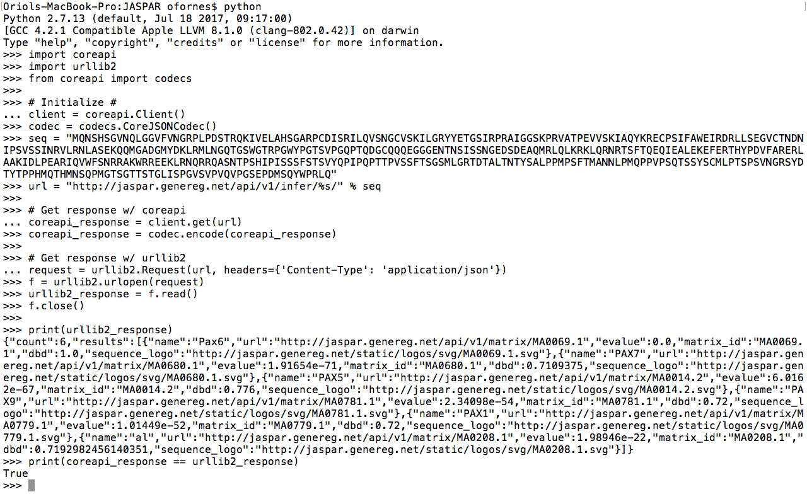
RESTful API
Notes:
Finally, the RESTful API can also be accessed in Python using the coreapi or the urllib2 modules. Here is an example of the code. Of course, one can use similar modules and other programming languages.

Slide 42
Outline
Overview
Manual Curation
Tools:
Profile Inference
Matrix Clustering
Genome Tracks
New Web Interface
RESTful API
Perspectives
MANTA2
Notes:
And finally future perspectives.

Slide 43
Perspectives
JASPAR beta (contains profiles/functionalities to be added to the next release)
Validation section (contains profiles that we failed to validate through literature support)
Genome tracks at user’s request?
While we are close to profile every human TF (except for zinc fingers), we don’t have an estimate on the % of covered binding modes, heterodimers, etc.
Notes:
First, we are planning on developing a beta version of JASPAR. A validation section to store profiles that we missed to validate during our manual curation of profiles, including TFs for which profiles do not exist, for experimental people to validate. Given their popularity, we are thinking on generating genome tracks at per user's request. Problem here is that each genome track and accessory files take ~150GB of space (depending on the species). Finally, while we are close to profile every human TF (except for zinc fingers), we don't know...

Slide 44
Outline
Overview
Manual Curation
Tools:
Profile Inference
Matrix Clustering
Genome Tracks
New Web Interface
RESTful API
Perspectives
MANTA2
Notes:
To finish, I would like to introduce you the 2018 update of our Mongo database for the analysis of TF binding site alterations MANTA. This work has been done in collaboration with the Mathelier Lab, specifically with Marius.

Slide 45
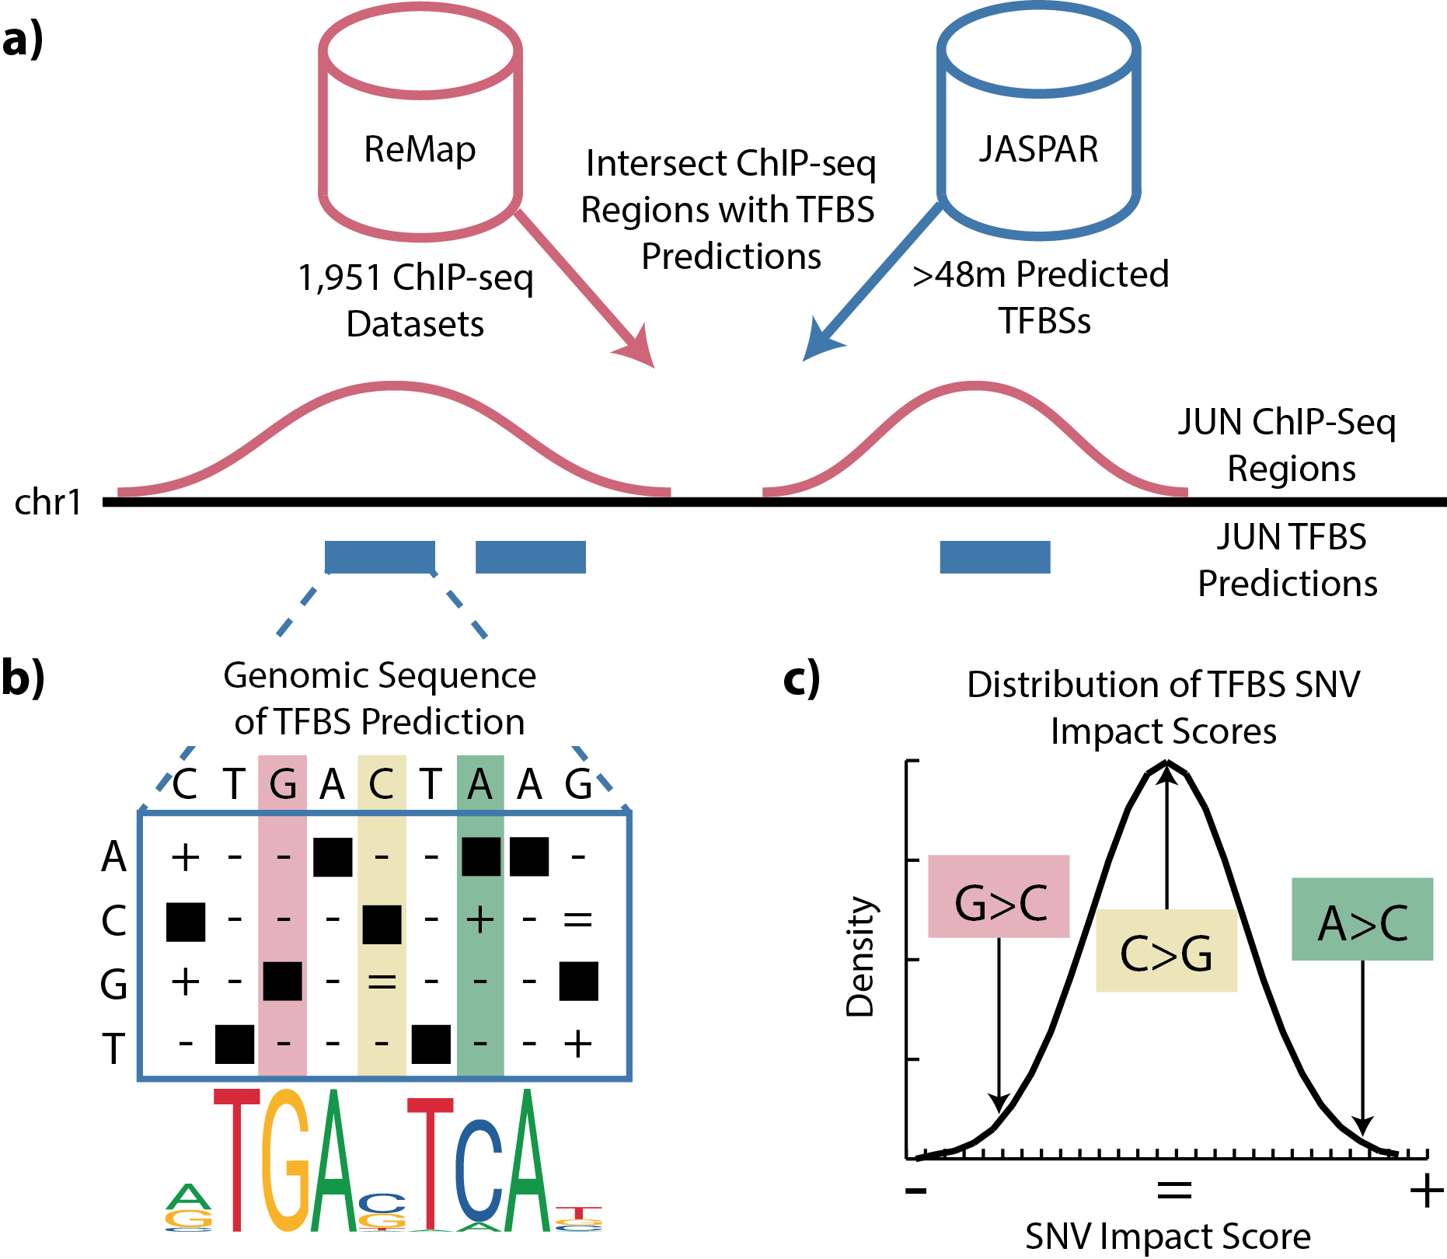
MANTA2
Notes:
MANTA stores TF binding site predictions within ChIP-seq regions, as well as the potential impact on TF binding of all single nucleotide variants within these binding sites. Benefiting from the recent updates of ReMap and JASPAR, we intersected the ReMap ChIP-seq regions with the JASPAR genome-wide TFBS predictions, increasing the size of the database by more than 5-fold. Variant impact on TF binding was predicted by means of Z-scores obtained from the distribution of relative scores for that TFBS.

Slide 46
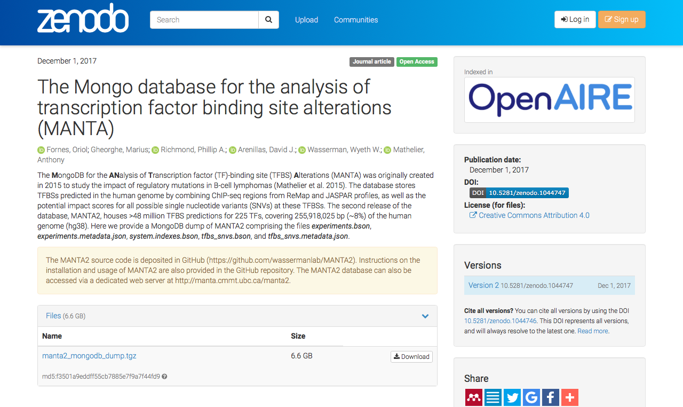
MANTA2
Notes:
MANTA2 is available for download at Zenodo.

Slide 47
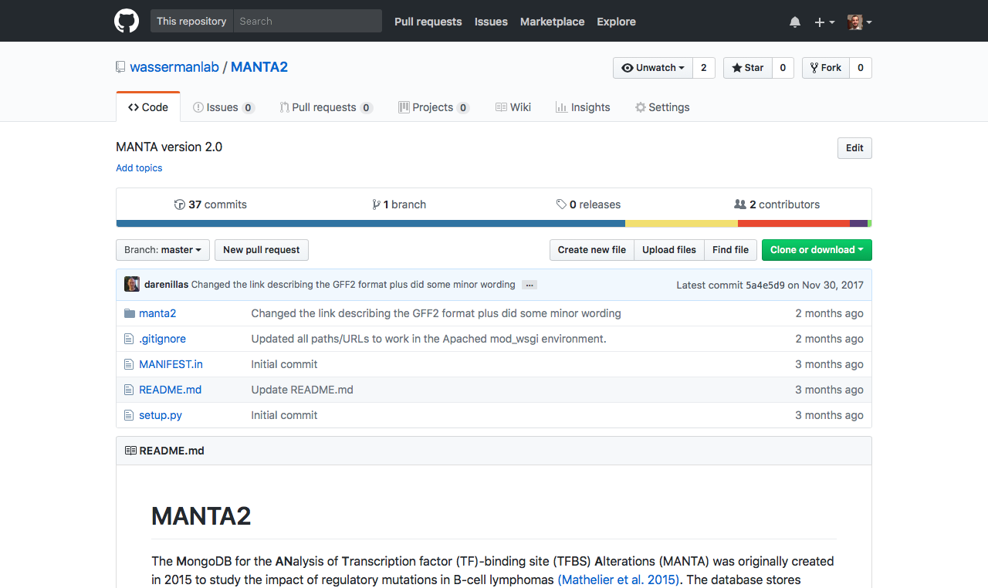
github.com/wassermanlab/MANTA2
Notes:
And the scripts for its programmatic access are available as a GitHub repository.

Slide 48
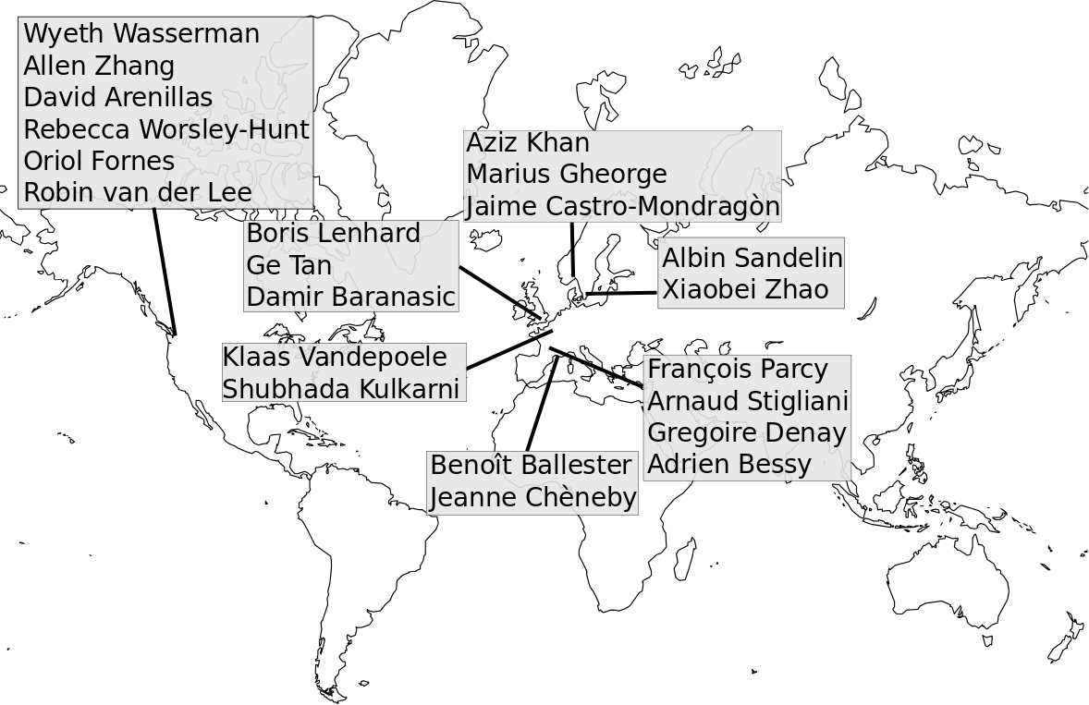
The JASPAR Consortium
Anthony Mathelier
Notes:
And that’s it. Here is a distribution of members from the JASPAR consortium. Highlighted are the members present at this GREEKC Meeting.

Slide 49
Acknowledgements
Funds from Genome Canada and the CIHR (OnTarget grants 255ONT and BOP-149430) and the Weston Brain Institute (20R74681)
WestGrid (www.westgrid.ca) and Compute Canada (www.computecanada.ca) support for genome tracks
Special thanks to the scientific community for performing the experiments and for publicly releasing the data
Notes:
And finally, I want to thank my funding agencies, Westgrid and Compute Canada for compute support, and specially the scientific community for performing the experiments and publicly releasing the data.

Slide 50
Questions
Notes:
That's it from my side, now I will be taking in any further questions you might have.

Slide 51
TF Coverage for Human
Notes:
Describe this slide…

Slide 52
Genome Tracks Usage
Notes:
Describe this slide…

